Slide 1
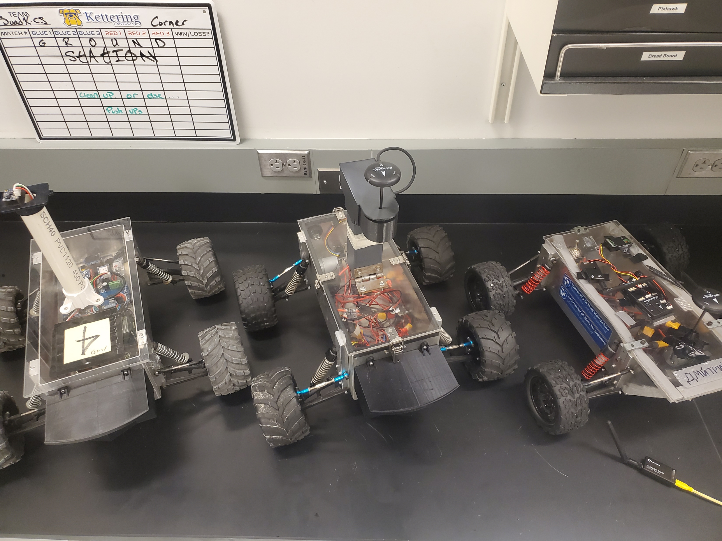
ET NavSwarm: PCB Design – Nick Snyder
What is it?
Fleet of autonomous rovers
Goal of prospecting for extraterrestrial materials
Integration with other ACL projects

Slide 2
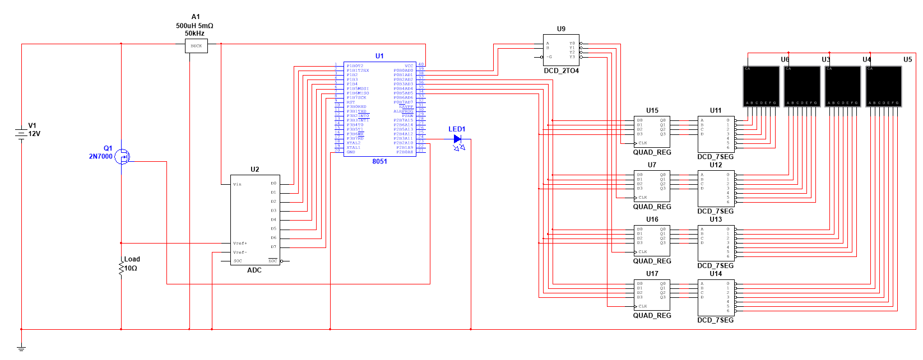
What am I doing?
Custom ESC with auxiliary functions

Slide 3
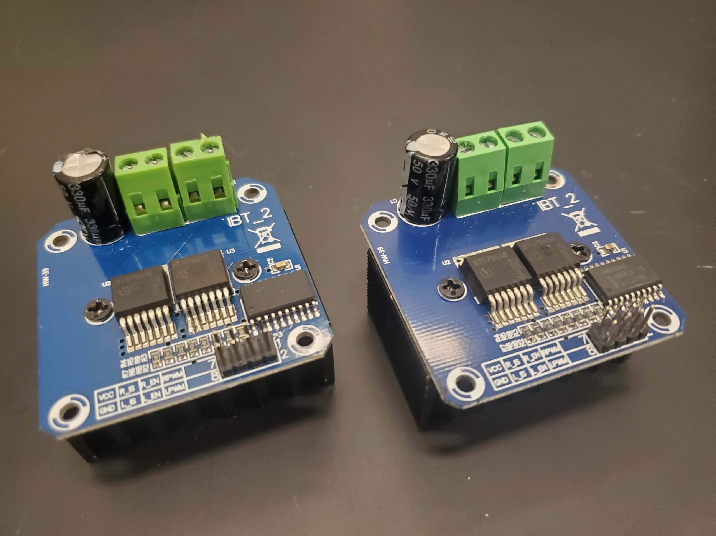
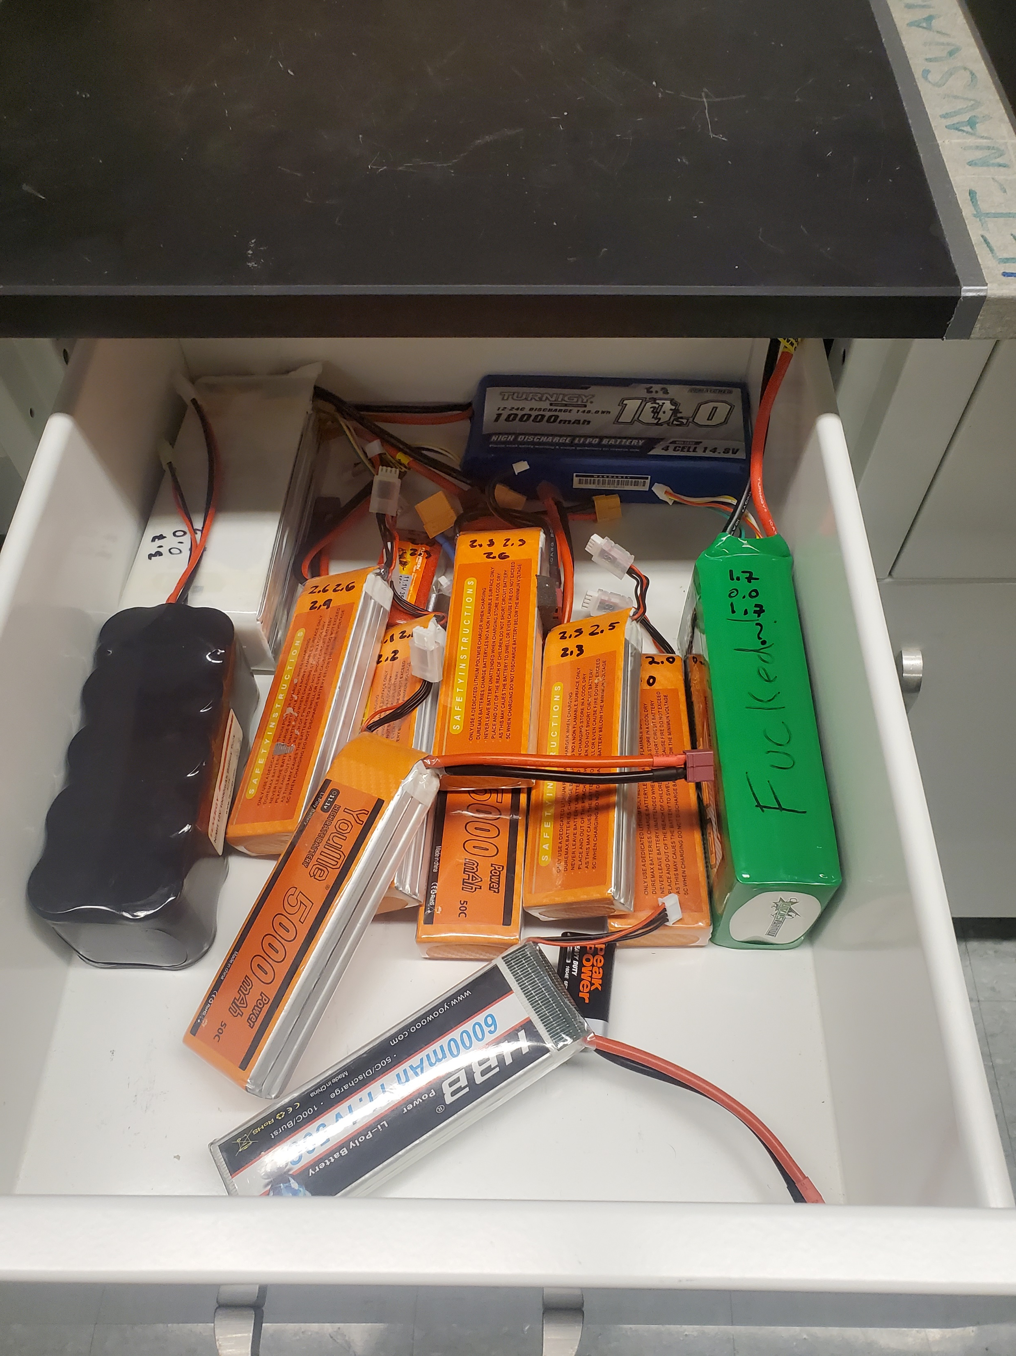
Why would I do this?
Mess of wires
High quality ESC
Battery monitoring functionality

